Slide 1
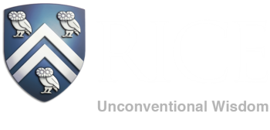
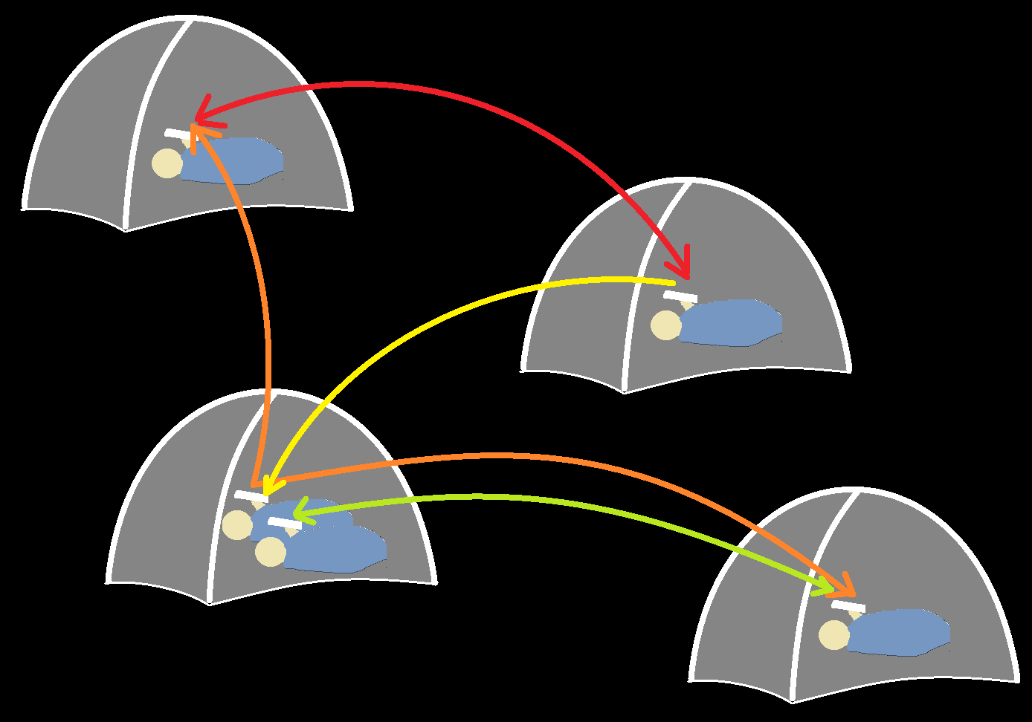
A Chatting App Based on Bluetooth Network
PRESENTED BY:
Li Ding
Xiaoqin Li
Jieru Song
Yiding Xu
Rice University
3/15/2015

Slide 2
Agenda
Motivation
Background
Methodology
Demo
Challenges and Lessons
Summary and Future Work

Slide 3
Motivation
Objective
Develop a network based on multi Bluetooth connection
Allowing users to send messages to any end node of this network
Very useful when neither WIFI nor cellular data is available
Notes:
<number>

Slide 4
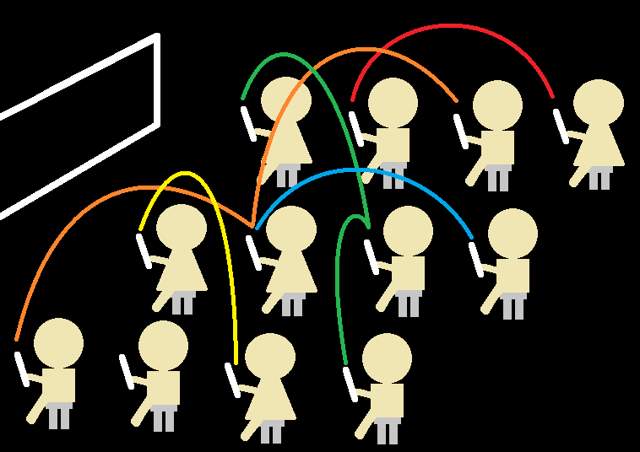
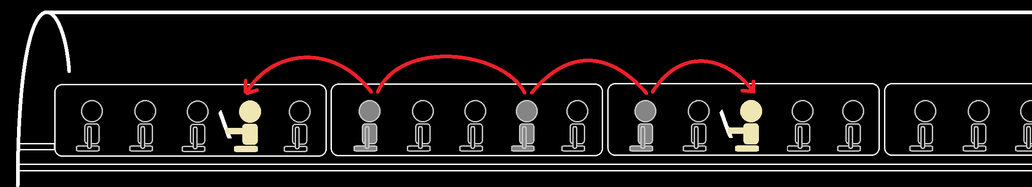
Motivation (Cont.)
Scenarios
No data plan, no Wi-Fi
High school kids
Cellular data and Wi-Fi not available
On the subway

Slide 5
Background
[1]
Bluetooth Fundamentals
Frequency:
from 2.4 to 2.485 GHz
79 1-MHz channels.
Physical range
10-100 meters
Performance
1-3 Mbit/s data rate
100ms latency
100ms total time to send data

Slide 6
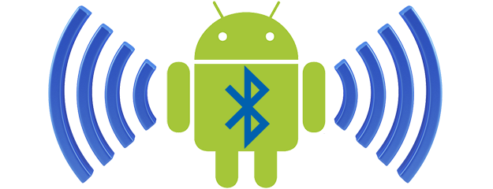
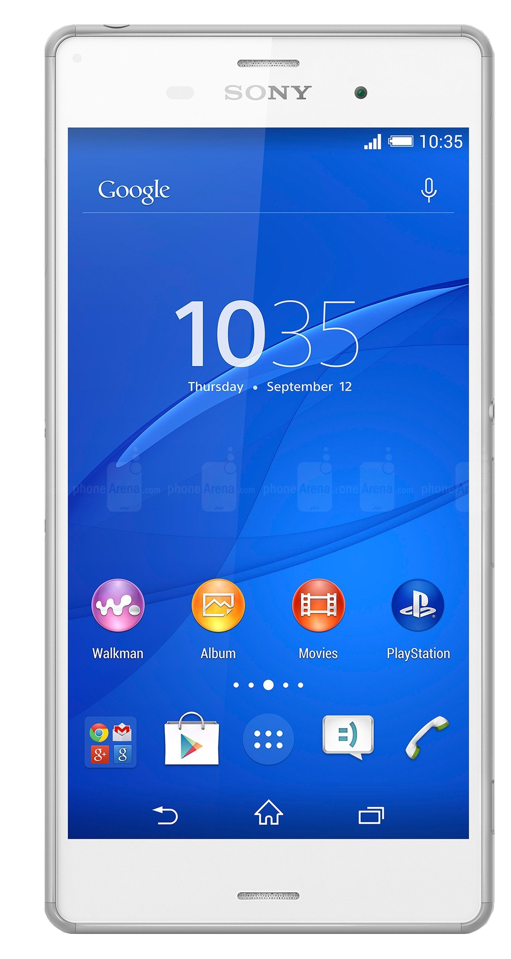
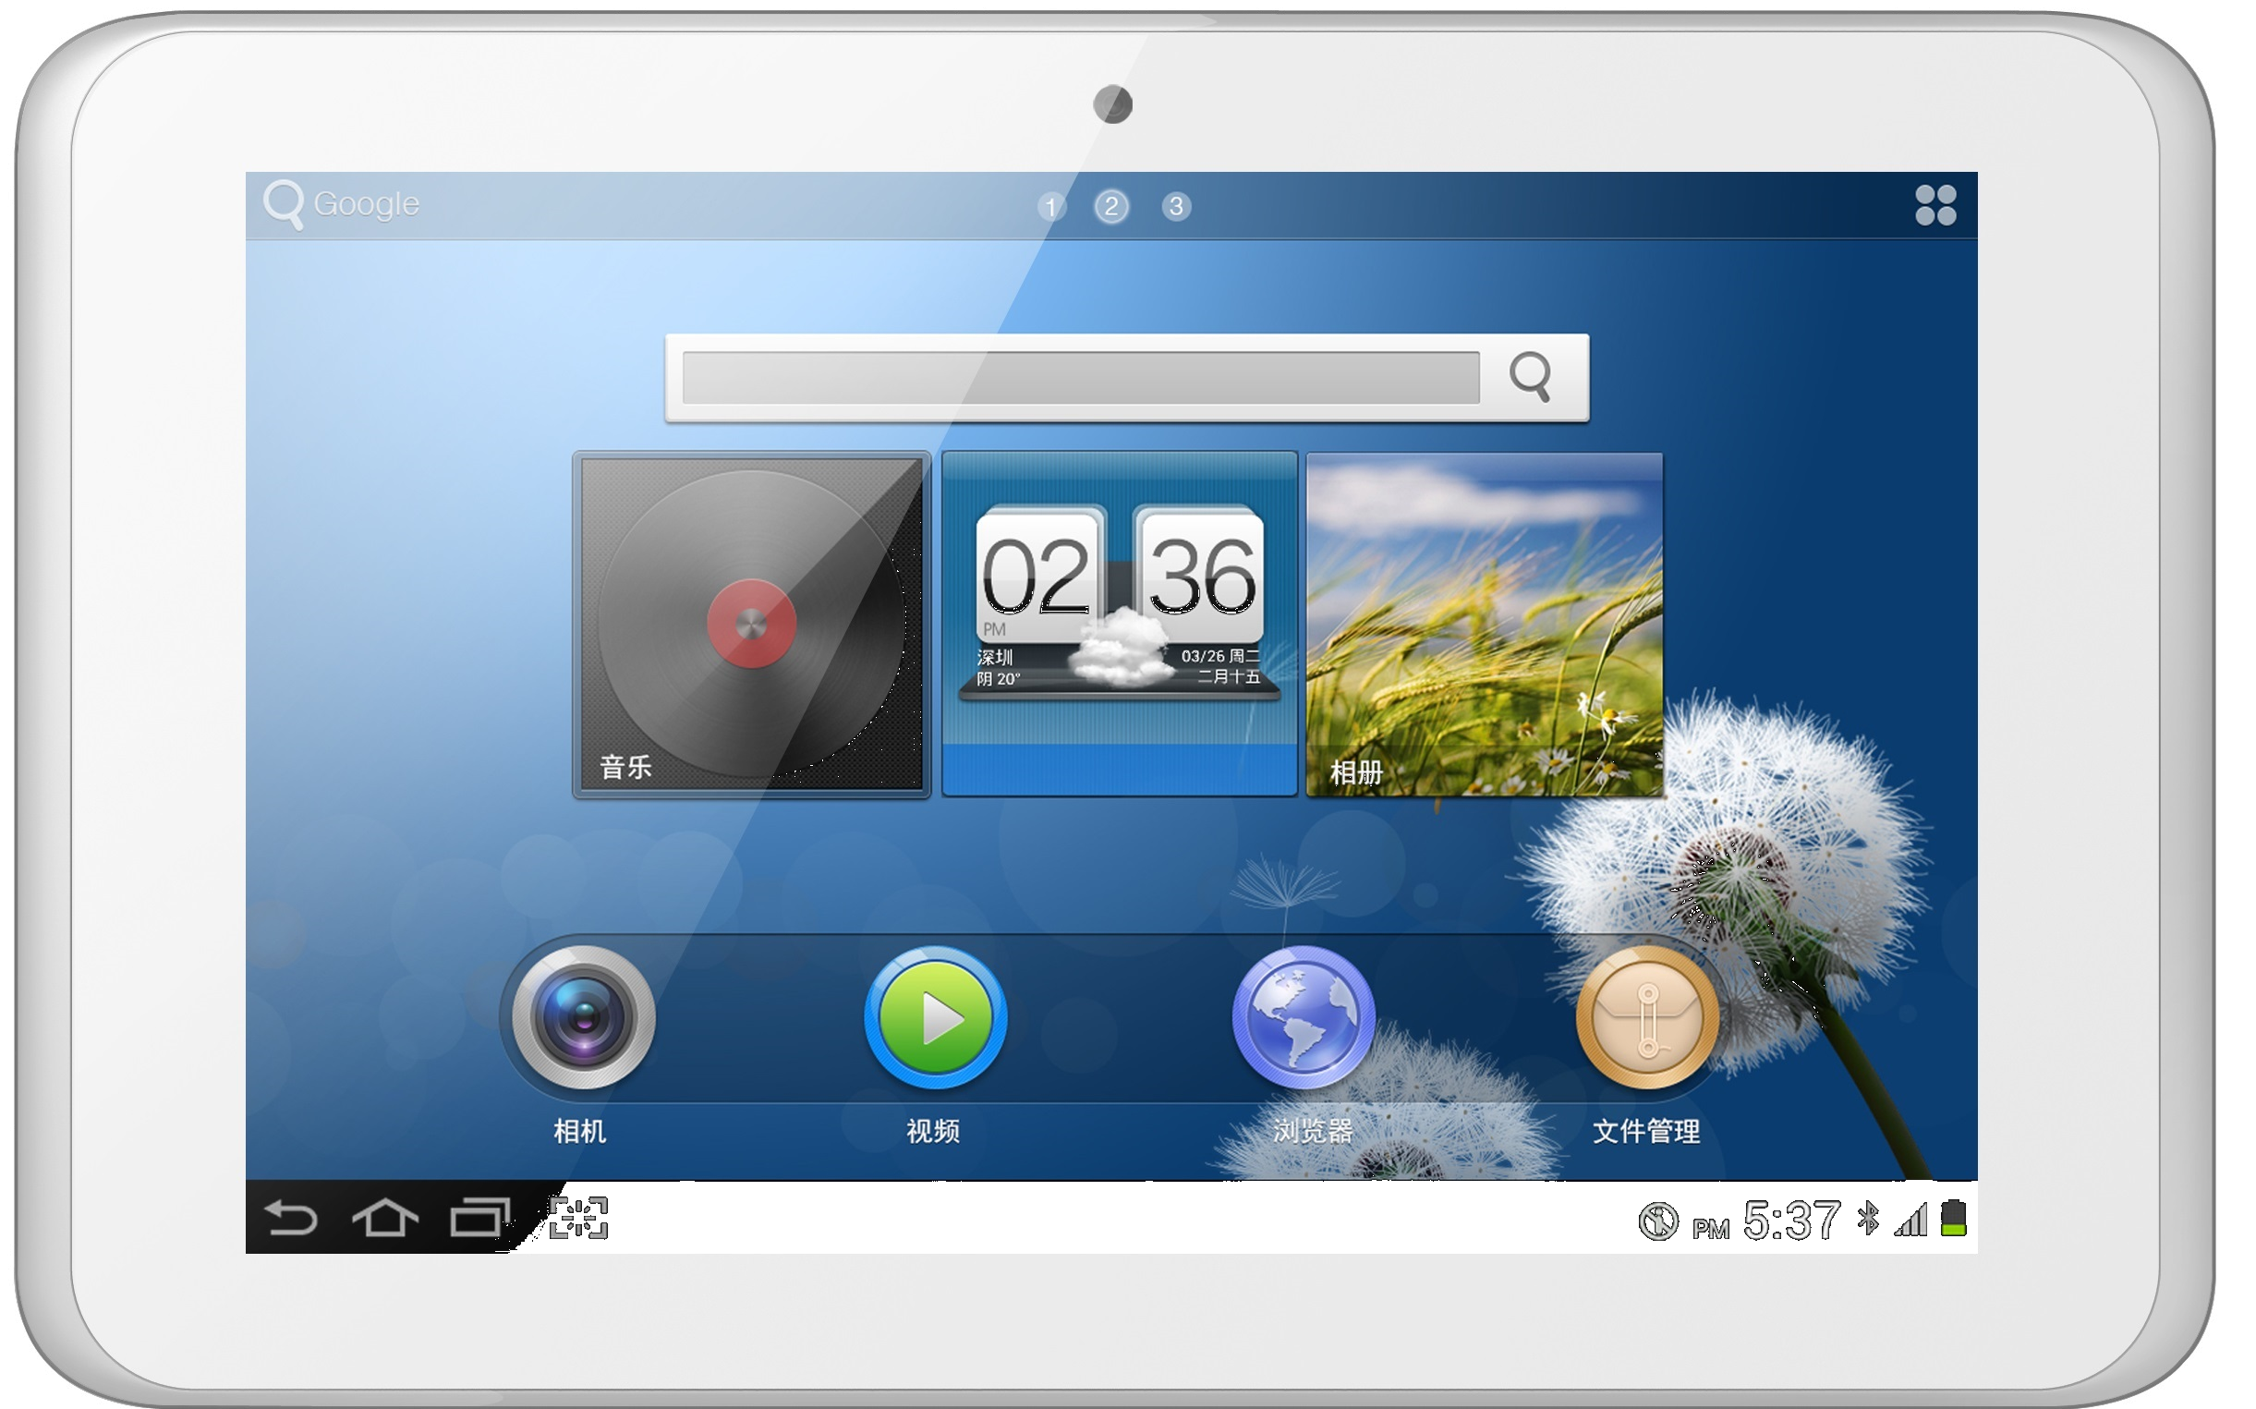
Methodology
Platform: Android
Device: Smart Phone & Tablet
Notes:
The platform on which we build this system would be android OS.
We will be using smartphones and tablets to test our system. The result of the project would be an Android app.
<number>

Slide 7
Methodology (Cont.)
Architecture
Upper Class (Android UI)
Middle Class
(Network and Topology)
Lower Class
(BlueTooth Multi Connection, messaging)
Notes:
Here is our Architecture of the whole system. There would be three layers of our architecture. The lower layer, the middle layer, and upper layer.
<number>

Slide 8
Methodology (Cont.)
Architecture (Cont.)
Scan and discover devices
Connect/disconnect devices
Maintain all directly connected device map
Lower Class
Send and receive data
Listen to in-coming data
Middle Class
Maintain and update network topology
Decide actions of Lower Class on sending data
Upper Class
Decide actions of Lower and Upper Classes
on receiving data
Interact with users
Call Middle Class on User’s request
Notes:
The lower layer would be responsible for …
More specifically, in this layer, what we could see, is a device and it’s direct neighbour. It will be able to send data to it’s direct neighbor. The content of the data is not known by this layer. The data is given to this layer by the middle class. All this layer need to do is sending it to a neighbor that the middle class specified.
This layer would also listen to incoming data. Again, lower class does not understand the content of the data. This data may be a message from one user to another, it may be configuration and topology information. Lower class would simply notify the middle class that there is new data coming, and the middle class will handle it later on.
As this layer can see it’s direct neighbor, when there are new neighbor coming and leaving, it will listen to this information and tell it to the middle class.
Now our middle class would have a view of the whole network. The protocol is implemented in this layer. Depending on the protocol, it may or may not know the whole topology of the network, but it will always maintain the information of all users in the network.
When upper layer want to send a message to a user, first of all, the middle class would generate a data with specific format that the protocol decide. It may contains information like sender, receiver, sequence number, and the message itself.
Since the destination of the message may not be directly connected to this device, the middle class is responsible for finding a way to send the message to the user. It will calculate the next hop and send it the data.
When the lower class notify this middle layer that there are neighbor coming and leaving, the middle class would then figure out who are now in the network based on the information it have. It will also sent out data containing topology information if it is necessary. Then, the other devices would be able to know topology change in the network.
The upper class is closely related to Android programming and user interface. The middle class would tell this layer all users connectable. It will send and get messages using the middle class. This layer will maintain conversations with other users. When there are any change, this layer will be responsible for displaying it correctly.
<number>

Slide 9
Methodology (Cont.)
Bluetooth Multi Connection
(concurrency in Android Bluetooth)
ConnectThread
(Sending connection request)
AcceptThread
(Listening any connection request)
ConnectedThread
(Listening any read and write requests)
ConnectedThreads
(The map maintains connections)
BlueTooth Socket
(Connection, reading and writing)
Notes:
Xiaoqin’s presentation ends here, which shall consume around 7 minutes.
<number>

Slide 10
Methodology (Cont.)
Routing Algorithms
Flooding
Initially used
Performance baseline
Link-state combined
Better solutions
Notes:
Then I will talk about the design of the middle layer. It is mainly for connecting the UI and the hardware, as well as maintaining the network topology and deciding the routing strategy.
The routing algorithms we choose in the end is an optimized flooding strategy, which is a combination of link-state algorithm we studied in last semester with the flooding strategy. Firstly I will introduce the naïve flooding strategy, as well as its problems and our solutions, then how we combine it with link state algorithm, and in the end, propose a better solution.
<number>

Slide 11
Methodology (Cont.)
Flooding Strategy
On new User:
Broadcast AddNeighborMsg to tell new user’s coming
Send also its reachable users
On user leaving:
broadcast RemoveNeighborMsg to tell new user’s leaving
On text message:
Send: broadcast
Receive: if is the receiver, display
else broadcast
Notes:
The original flooding strategy is pretty simple, there are in total three aspects to be considered. …..
<number>

Slide 12
Methodology (Cont.)
Problems Solving
Receiving one message infinite times:
Scenario:
A----C----B, B is sending a msg to A
Solution:
Traverse the msg path
Access of one message to one device -> only one time
For more times, discard
Notes:
However, flooding strategy does not work in many scenarios. E.g. when A connects to C an C connects to B and B wants to send a message to A, A will receive the message for infinite times. Because besides directly sending msg to A, C will broadcast it back to A and receive it again. Solution to this problem is to limit the access of one message to each device only one time. If it goes to a device twice or more, it will be discarded.
<number>

Slide 13
Methodology (Cont.)
Problems Sovling (Cont.)
Multiple occurrence of same message STILL NOT SOLVES
Scenario: 3 devices, each two connected:
3 times for each message
Pass C
A
Pass A
B
C
Pass B
Notes:
However, problem still occurs. Imagine the scenario three nodes ABC connect to each other, and A wants to send a msg to B. B will receive 3 msgs, each of it comes from a route from source to the sink.
<number>

Slide 14
Methodology (Cont.)
Problems Sovling (Cont.)
Solution:
Set sequence number for each message
UUID
one UUID displays only one time
record UUIDs occur before
Problem:
Memory explosion
Solution:
Set max UUID storage size
Notes:
Thus, the solution is to introduce the sequence #, in our case as UUID, to ensure each msg will be displayed for only one time. But this solution needs to record all UUID happened before. There would be a memory explosion when receiving large amount of msgs. So that we need to set the uuid records a reasonable upper bound.
<number>

Slide 15
Methodology (Cont.)
Problems Sovling (Cont.)
Scenerio:
A --- B --- C --- D
B is leaving, A can not delete C and D
Flooding can not solve in any way
Need to introduce new strategy to modify
Notes:
However, there is still a scenario flooding can not solve. When A connects to B to C to D, B is leaving now but A can not find C and D. A should delete B/C/D from its available user lists but it actually only delete B, since B does not provide how it connects to the C’s sub-network. Thus we need to introduce new strategy.
<number>

Slide 16
Methodology (Cont.)
Link-State Strategy
Flood based
Each node records the whole topology of the graph
on new direct neighbor:
broadcast notification to all reachable users, ask them to send their direct neighbors to help each user update topology
on direct neighbor leaving:
broadcast notification to modify adjacency matrix, delete unreachable branches
Display users: BFS
current DEMO based on effort until this
Notes:
We adapted the Link-state algorithm we studied in 429 to our flooding strategy. The main difference is that each user not only know current available users but also know the topology of the whole network. on new neighbor: we broadcast notification to all reachable users, ask them to send their direct neighbors to help each user update topology. on neighbor leaving: we broadcast notification to modify adjacency matrix, delete unreachable branches. Display users: BFS to find accessible devices. And current DEMO based on effort until this.
<number>

Slide 17
Methodology (Cont.)
Better Solution
Problem of Link-State Strategy: Traffic explosion
for each topology change, all users should send topology message in whole net.
O(VE) ~ O(V^3)
cause serious concurrency problems
Solution:
Decrease the connection redundancy of the whole network
Use Minimal Spanning Tree to keep connectivity
Notes:
But traffic is still a big issue. For each topology change, in our current strategy, all users should send topology message through the whole network. Time complexity is VE, E is of size V square, that in total V cubic. Also, when multiple topology changes happen together, it will cause a severe concurrency problem. A better solution is to decrease the connection redundancy of the network, the connectivity of the network will be kept only by the MST.
<number>

Slide 18
Methodology (Cont.)
Better Solution (Cont.)
Partition the whole network into piconet and scatternet
Piconet: consists of two and up to seven devices with
master node and slave nodes
Scatternet: interconnection of Piconets
Notes:
Based on this, the graph could still be improved by partition the tree into piconet and scatternet. Piconet is a small net that consists of two and up to seven devices with master node and slave nodes. And scatternet is the interconnection of Piconets. The main idea is to only generate spanning tree on scatternet, which treats each piconet as a node. The advantages of this design include that reduce traffic effectively and add robustness to net structure(the leaving of normal nodes in a piconet will not cause a global broadcast of topology msg, as well as change of the tree structure)
<number>

Slide 19
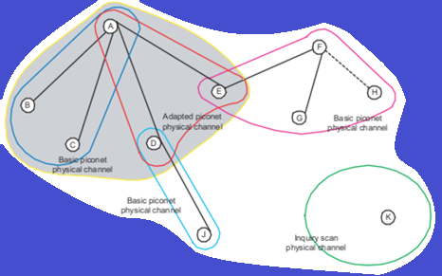
Methodology (Cont.)
Better Solution (Cont.)
Main idea:
spanning tree on master nodes
Advantages:
reduce traffic effectively
add robustness to net structure
efficient direct connections among neighbor nodes -> initialize and maintain the routing table on a node
reduce the number of route miss and corresponding route discovery
Notes:
Based on this, the graph could still be improved by partition the tree into piconet and scatternet. Piconet is a small net that consists of two and up to seven devices with master node and slave nodes. And scatternet is the interconnection of Piconets. The main idea is to only generate spanning tree on scatternet, which treats each piconet as a node. The advantages of this design include that reduce traffic effectively and add robustness to net structure(the leaving of normal nodes in a piconet will not cause a global broadcast of topology msg, as well as change of the tree structure)
<number>

Slide 20
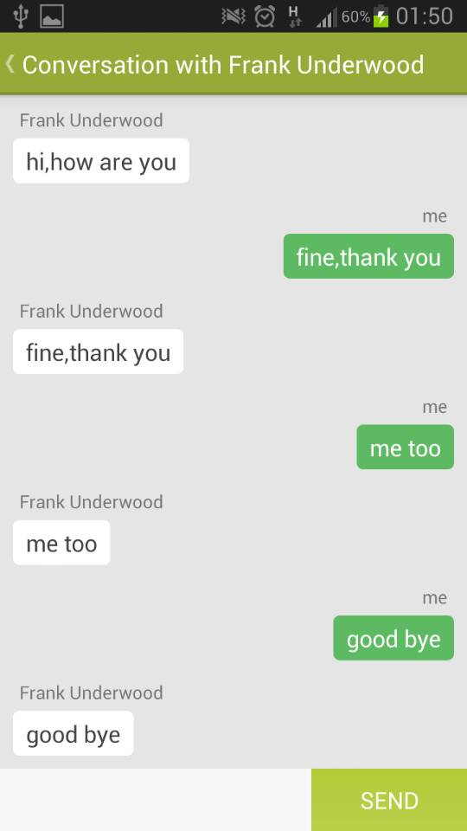
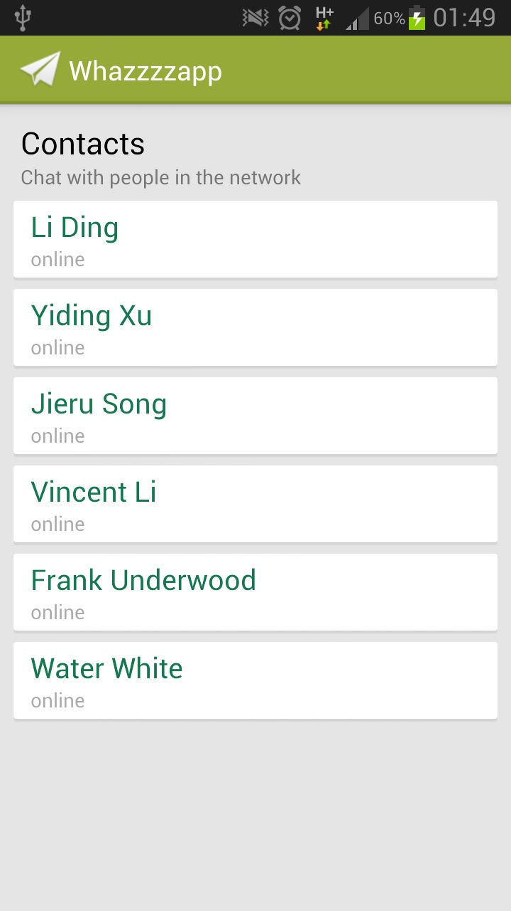
Methodology (Cont.)
Chatting Activity
Contacts Activity
Upper Class (Android Service)
Notes:
Now this is the upper layer. It is closely related to Android programming. I will not go through too much details here. Just some relevant concepts. Every user interface here are control by an android activity. The activity will tell the device what to display.
The upper layer that we are talking about is an android service. An android service is an element that does not have user interface. It will communicate with all other activities. It will also provide functions for the user interface to send and receive data from our bluetooth network.
Now how does this app actually look like? Let’s start our demo here.
<number>

Slide 21
Project Quick Demo
Let’s Chat a bit!

Slide 22
Challenges
Different Bluetooth versions
Testing in Large Scale
LESSON LEARNED
Start as early as possible
(Time consuming on Android debugging)
Be more familiar with Bluetooth hardware in different android device with different version
Notes:
1. Bluetooth is designed for peer to peer connection. It is not designed for multiple connection. The bluetooth socket have very different behavior compared with TCP socket. In older version of Android, less than android 4.3, there are different kinds of bugs when trying connecting multiple devices at the same time. Different phone manufacturer may have slightly different behavior. Which all make our project difficult.
The existing apps of bluetooth chat usually have a chat - room styled design. There are not building a user to user conversation. Testing such app would be easier.
But for our project, testing should include large scale testing, so that we could know the perfomance of the network. Although we did borrowed up to ten devices, many of them is having older version of android and bluetooth. Also, testing different topology may be different because of the range of bluetooth, a lot of devices can directly link to each other. When sending messages, there would usually be a maximum of two hops when we are testing. It is extremely difficult to set up some complicated topology we want.
<number>

Slide 23
Summary & Future Work
Bluetooth Network: an option for message delivery
Experiment on different data transmission protocols
Better user experience
Acknowledgement
Many thanks to Professor Eugene Ng for the inspiring discussions
References
[1] "Basics | Bluetooth Technology Website". Bluetooth.com. 23 May 2010.
Notes:
although the direct reaching distance of Bluetooth connection is only 50 meters, the network based on Bluetooth could enable people to send data or messages to any end nodes of this network. It would significantly increase the reaching distance of the users, and it could be very useful in some scenario when none of WiFi, 3G/4G data service or telephone messaging service is available.
<number>

Slide 24

Q & A
Thank you for your attentions
Notes:
Thank you very much for your attentions, and We would love to answer any questions in next 5 minutes.
<number>

